Slide 1
Electric Power Subsystem (EPS)
Reece Krantz – Electric Power Subsystem Lead

Slide 2
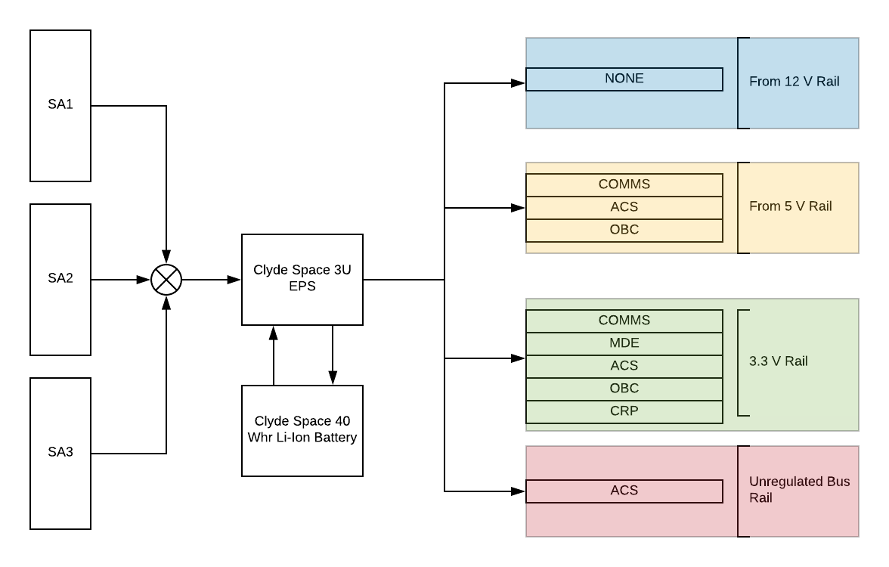
Mission Overview
The Electric Power Subsystem is responsible for the power management and distribution of the satellite.

Slide 3
Clyde Space EPS Board
Maximum Ratings
Buck BCRS – 30V
SEPIC BCRS – 9.5V
Battery – 8.3
Operating Tempurature -- -40 to 85 C
Storage Tempurature -- -50 to 100 C
Vaccum – 10^-5 torr
Radiation Tolerance – 10 kRad

Slide 4
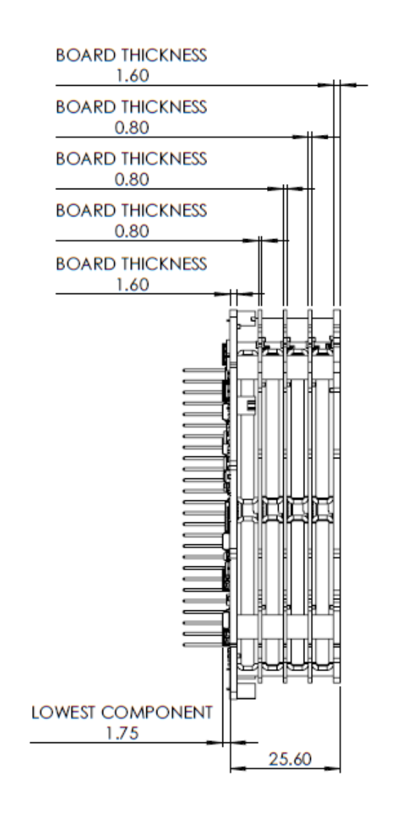
Clyde Space 40 Whr Battery
Operating Temp
-10 to 50 C
Storage
-10 to 10
Vacuum of 10^-5 Torr
Max Ratings
Charge
8.4 V
8 A
Discharge
6.2 V
8 A

Slide 5
EnduroSat Solar Panels
Seven CESI Solarcells
211.05cm^2 effective cell area
Temperature Sensor
8.43 Watt in LEO
Gyroscope and Sun Sensor
Max Voltage of 16.31V
Max Current 517 mA
Weight of 136g

Slide 6
Power Modes
Power Mode analysis allows unique modeling for any orbital configuration.

Slide 7
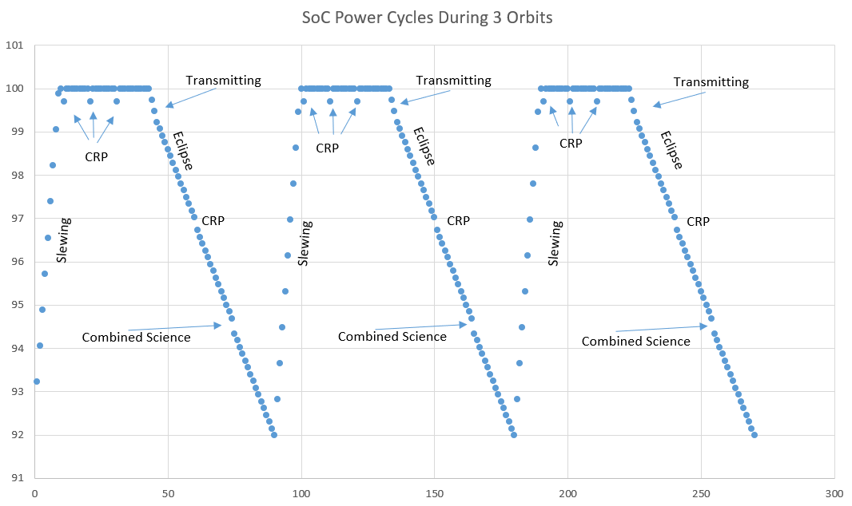
Power Modes
Activity Planning in Orbit
Accomplish Scientific Goals
Provide arcs for Communication with GS
Realistic Operation of Spacecraft
Different Analysis of Power Budget
Aids Software Design
Block Diagrams

Slide 8
Power Budget

Slide 9
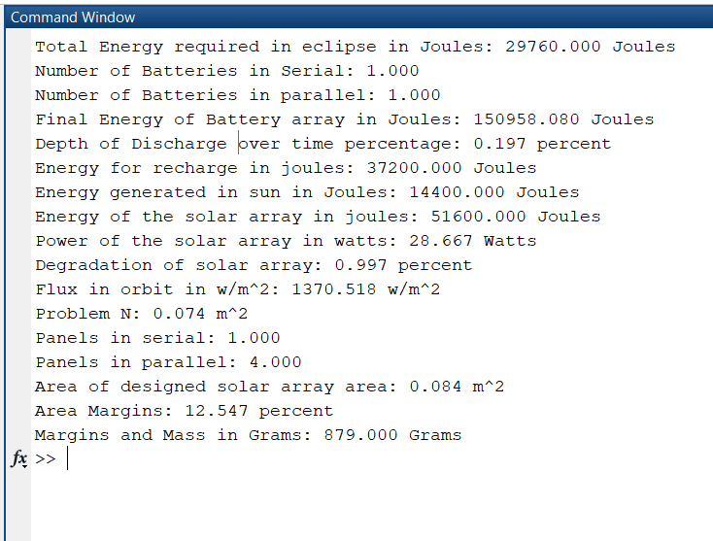
EPS Simulation
Relative Two-Body Problem Propagation
States using Runge-Kutta
Initial Conditions of ISS plus some dV for Sat
Always Sun Facing
Eclipse/Sun is instant

Slide 10
Animation of ISS and ES2 Orbit

Slide 11
Power Production

Slide 12
Array Energy

Slide 13
Power Difference

Slide 14
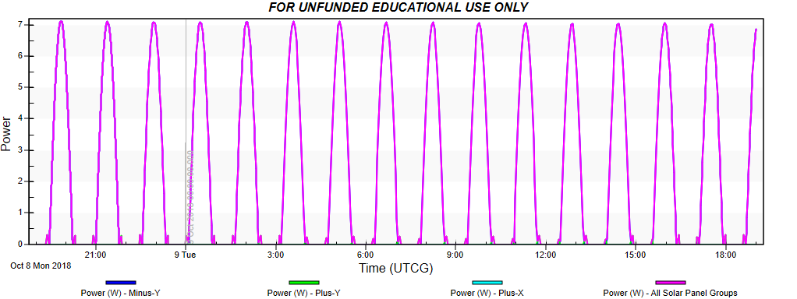
Improving Simulations
These simulations are good but can be better…
N-Body Universe
Spacecraft Orientation
Power Seen in Orbit (W/m^2)
Albedo Effects
Perturbations
Validation of Code
STK Solis

Slide 15
Real-Time Power Production

Slide 16
Real-Time Array Energy

Slide 17
Real-Time Power Difference

Slide 18
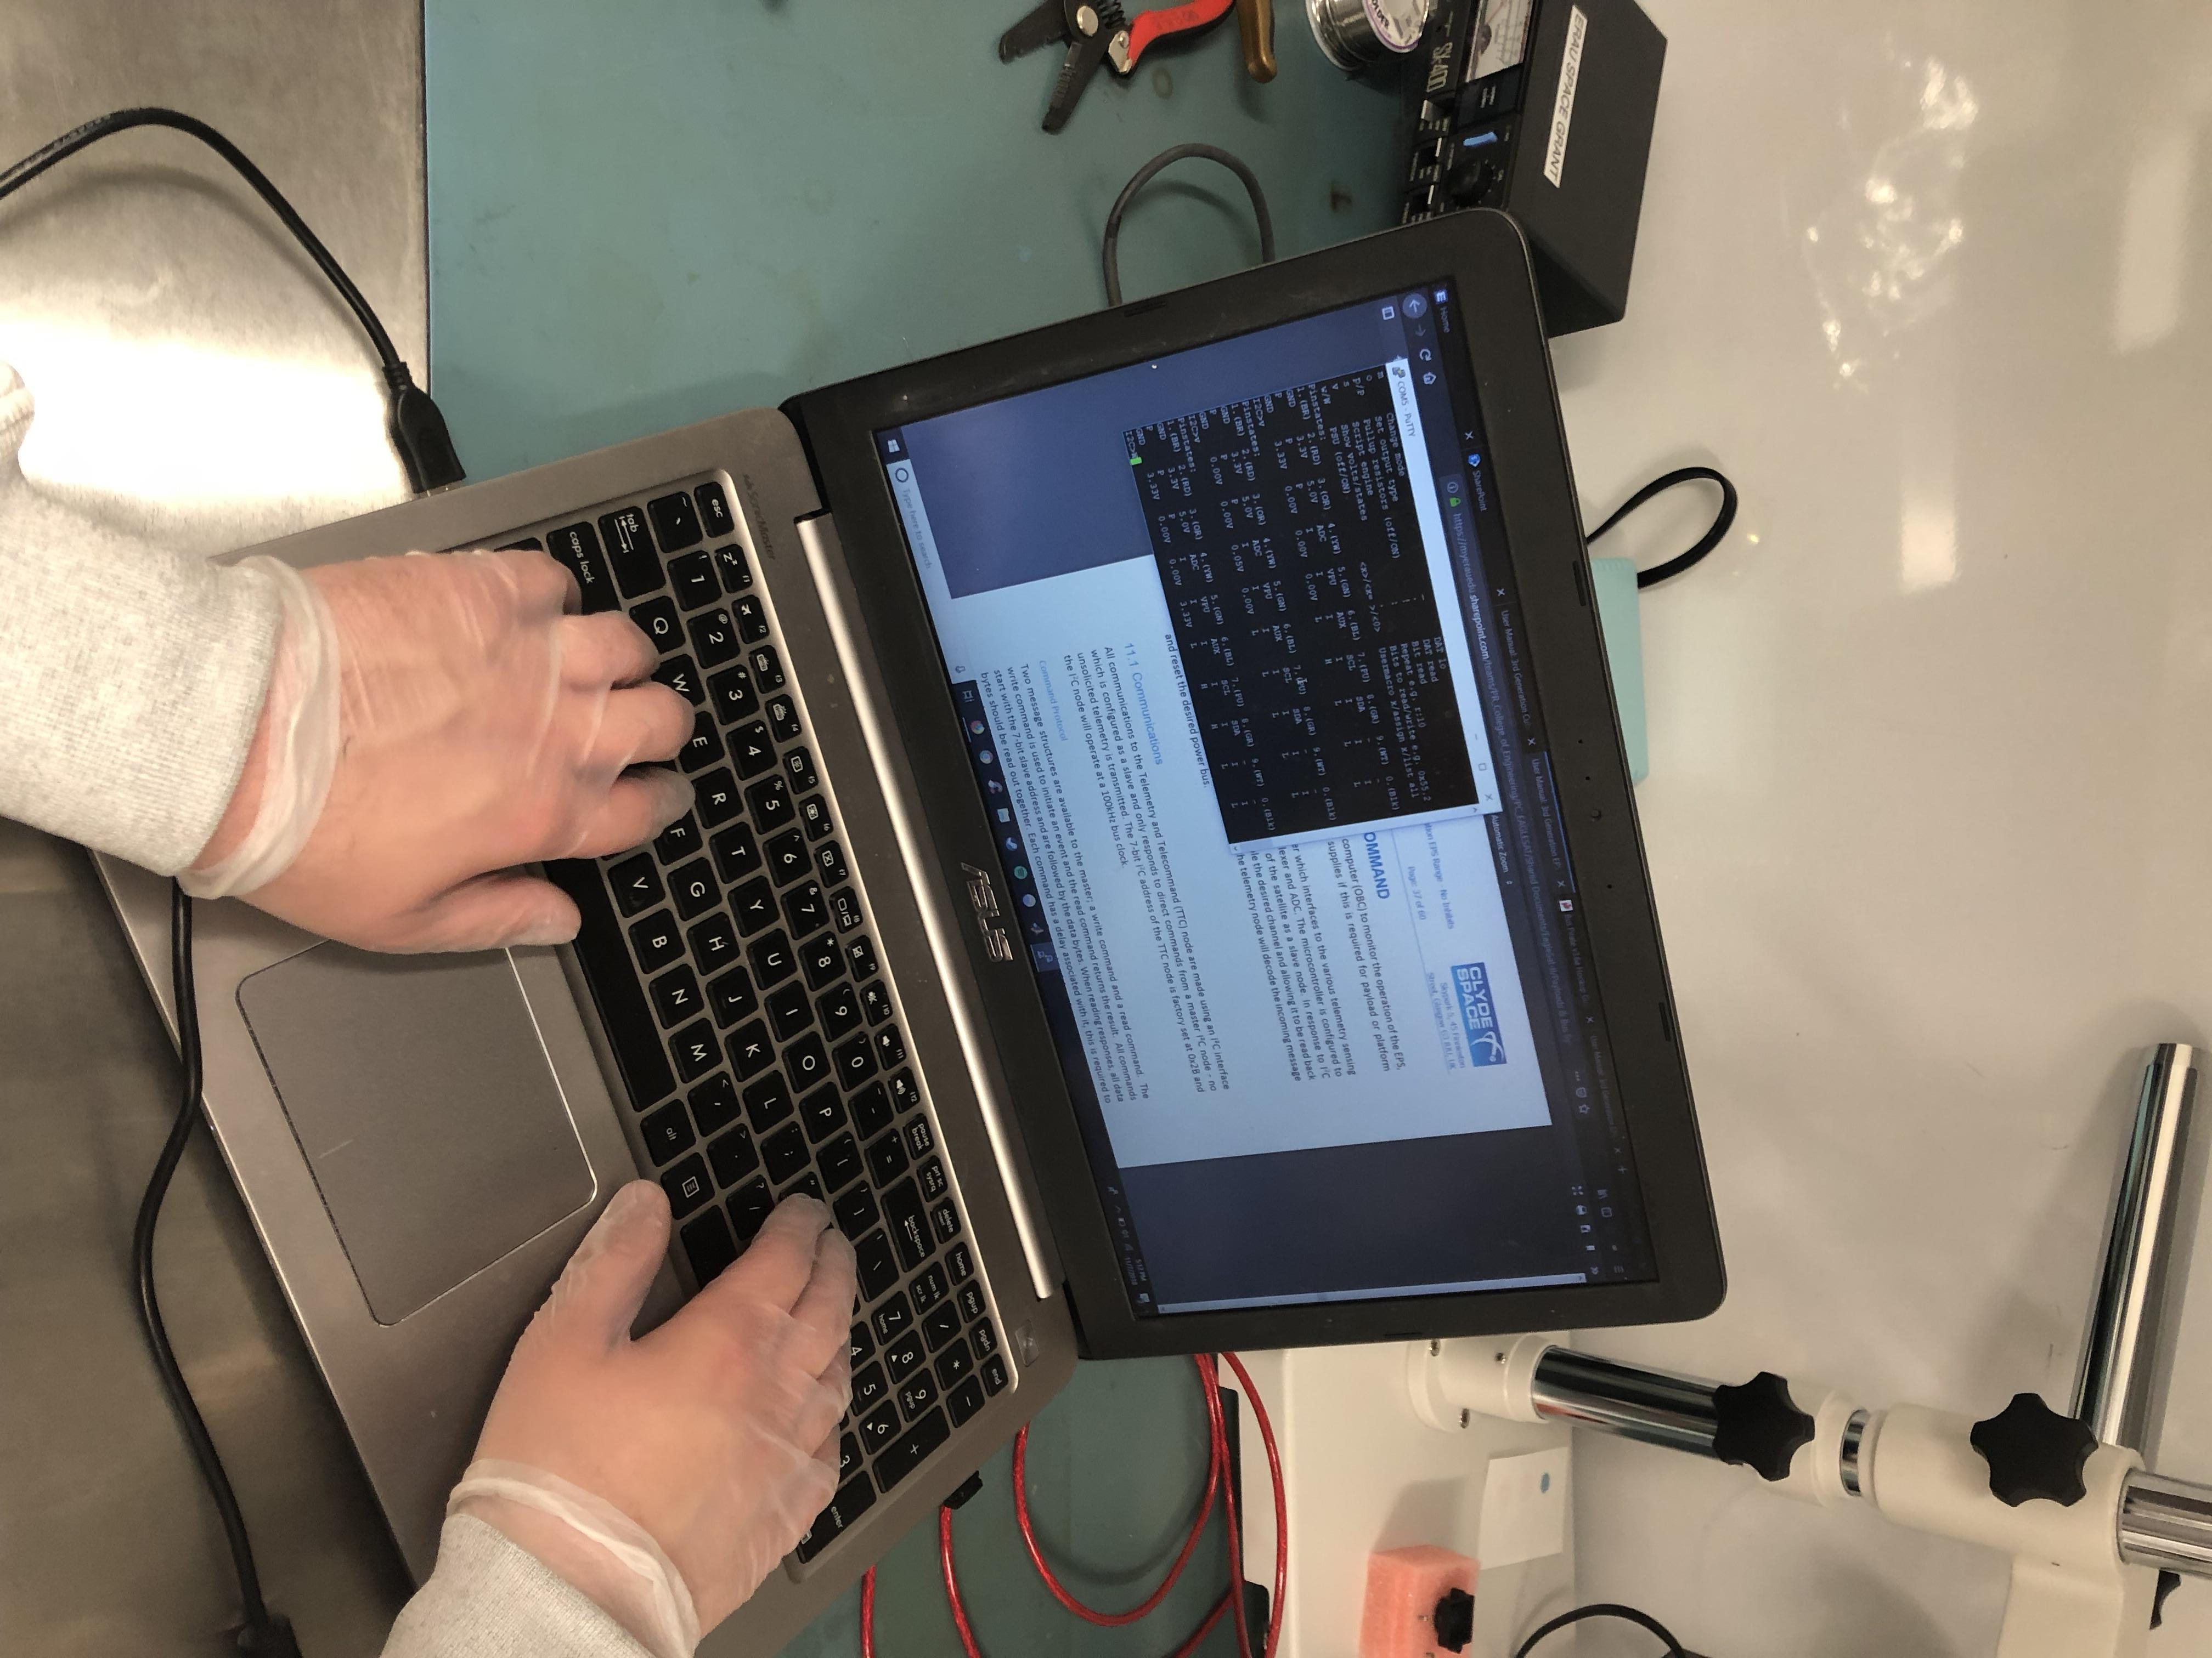
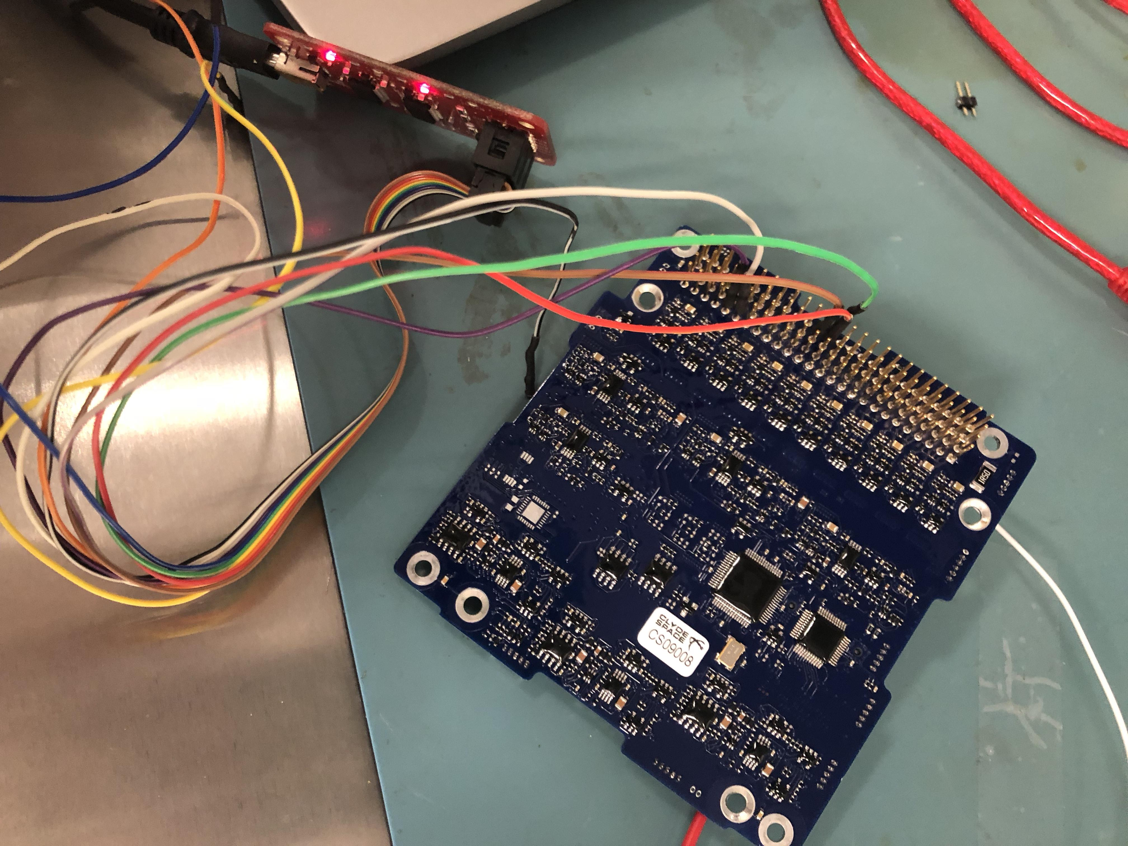
Testing
All testing is done in the clean room, with components being interfaced with I2C protocol
Using various systems including TI TM4C's, Arduinos and bus pirates.

